Slide 1
2020-2021 Second Grade Curriculum Night
Sonia Johnson
sjohnson@popejohnxxiii.org
www.johnson2b@weebly.com

Slide 2
Welcome to 2B!
Mrs. Sonia Johnson
sjohnson@popejohnxxiii.org
www.johnson2b@weebly.com
Mrs. Linda Callahan
Instructional Aide
Mrs. Debi Murphy
Instructional Aide
Mrs. Angela Cartwright
Instructional Aide

Slide 3
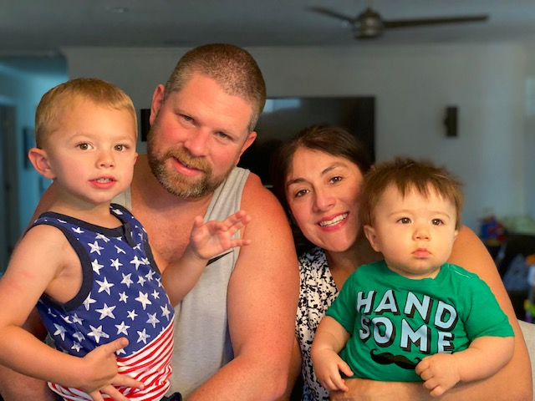
Who Is Mrs.Johnson? -A mom to Brady (3 ½ years) & Dylan (1 year) -A wife to Eric for 7 years -An avid baker, chocolate addict and traveler -A product of Catholic grade school and high school -A teacher in her 18th year of teacher! (Wow that makes me feel old.) Education -B.S.Liberal Studies, Minor in Child Development, California Polytechnic University San Luis Obispo -Multi-Subject Cross-Cultural Language and Academic Credential (CalPoly SLO) -Autism Specialist Certified -18 years teaching in Catholic Schools in California and Arizona

Slide 4
Take A Look Into 2B…
Daily Morning Routine
Wash Hands upon entering the room
Morning Work
Agenda Check
Pledge, Prayer, Mission Statement
Preview the daily schedule

Slide 5
Religion -Morning & Afternoon Prayer -Weekly Mass -Jesus Our Guide, Faith and Life Series -Reading from the Bible -Please seek out Sacrament preparation information from your own parish Spelling -Words are taken from weekly anchor story -Students receive words and sentences on Monday -Tests are given on Friday

Slide 6
Language Arts - Journey’s Reading Series (Weekly Reading tests on Friday) -Writing- Six traits, integrated with reading theme of the week -Whole group time- focus and practice on specific skills for the week (Phonics, Grammar, Vocabulary, Main idea, character, setting, etc.) Handwriting -Zaner-Bloser -Manuscript and Cursive Math -Singapore Math (Activity workbook, interactive, hands on activities) -Problem solving skills through word problems -Mad Minutes to improve math fact fluency -Whole group lessons, independent and guided practice

Slide 7
Science/Social Studies -Alternate Science & Social Studies -Curriculum follows Diocesan & State Standards -Hands on experiments, interactive learning, STEM labs -Social Studies and Science are also integrated in our reading series

Slide 8
Projects and Other Information -Students may receive projects and reports in lieu of normally scheduled assignments (President Projects, Saint Report, Book Talks) -Students will be given plenty of time and preparation -Book Talks will be assigned quarterly. Students will be able to choose a project to use.

Slide 9
Homework Policy -Homework is daily and expected to be submitted into Schoology by 8 am the following day unless otherwise notified -Agendas are used daily & need to come back daily Reading Logs: Students are expected to read 10 minutes daily. Parents need to sign off each night. Logs are checked daily. The log will be submitted into Schoology into Language Arts Thursday folder of the current week. Math: Students will receive Math workbook or digital homework 3-4 nights. These are meant as extra practice. IXL Math: 30 minutes of IXL practice in a given skill will be assigned most weeks. Students will receive a completion grade weekly. Some off weeks.

Slide 10
Classroom Discipline Class DOJO -Students may earn or lose points for following classroom rules, expectations, turning in homework on time and participation throughout the day in all classes. -Students are shown their points at the end of every day and it is their responsibility to claim rewards. -Students that are virtual will still be able to earn and lose points. Additional Actions: -Name on board -Reflection time during recess on what better choices could have been made -Incident Reports Our main goal in 2B is for students to accept responsibility for both negative and positive choices. If a student is able to acknowledge that they made a mistake, then they are able to learn from that mistake and make a better choice next time.

Slide 11
Other Important Information ITBS -Spring date TBD Drop Off -Classroom doors will open at 7:45 -Parents are asked to say good-bye at the door Absences -If your child is absent, any missed work that cannot be completed in class will be sent home. They have the same number of days missed to complete the assignments. Please let me know if you know your child is going to be absent. -Your child may also access our lesson virtually.

Slide 12
Self-Accountability: Students are responsible for entering and exiting their classroom prepared for the day ahead. It is their responsibility to have their work, be ready to participate and be kind to one another. Please help support their independence. Mistakes happen, please help them learn from their mistakes. If an assignment was accidentally not completed, I encourage them to turn it in the following day and to accept that consequences. It will help them in the end. Agendas/Yellow Folder/Green Folder -Homework & Spelling words will be written down by the student in agendas. -Yellow folders (HW) and agendas should come back and forth to school everyday. -Friday Green Folders will have graded paper work and returned on Mondays with parent log signed.

Slide 13
Other Continued… Snack -Every morning -Please be sure to adhere to Diocese policy (healthy options only) -No nuts! Lunch -In the classroom -Hpt lunch will start September 8th (or later) -No Nuts

Slide 14
COVID Procedures Handwashing -Every time we enter the room -Bathroom Breaks -Before and after snack and lunch -Sanitizer is always available and students may have their own at their seat. Distance -Desks will be 3 feet apart -Recess zones -Backpacks/Lunch bags will be kept desks/chairs

Slide 15
Sanitizing -Room will sanitized throughout the day -Single Packs of Kleenex at desks Masks -Diocese has a cloth mask mandate -Have an extra mask in your child’s backpack -Mask breaks will be taken outside & appropriately spaced out.

Slide 16
Virtual Learning and Schoology Virtual -Log in at 8:00 am for first half of the day -Second link will be after lunch for the remainder of the day -Students are expected to stay on screen for the entire period and participate Schoology -Work will continue to be submitted via Schoology for those virtual and in person. -Graded Work can be viewed in Schoology Grades -Grades are updated daily. Please access RenWeb for student grades and comments.

Slide 17
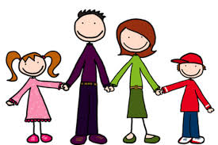
It Takes A Village… If you ever have a question or concern, please feel free to email me. Communication is one of my top priorities. Nothing should come as a surprise. Weekly Newsletters are posted to our class website every Sunday. I do my best to respond to emails promptly. Please don’t ever feel that I’m ignoring your email. Homework is posted daily by 3:30 pm. Remember we are all in this journey together, students, parents and teachers. Unexpected life events happen. Let’s help each other out. Thank you for your patience, flexibility, kindness and support. Let’s make this year a great one!

