Slide 1
2022-2023 Second Grade Curriculum Night
Sonia Johnson
sjohnson@popejohnxxiii.org
www.johnson2a@weebly.com

Slide 2
Welcome to 2A!
Mrs. Sonia Johnson
sjohnson@popejohnxxiii.org
www.johnson2a@weebly.com
Mrs. Linda Callahan
Instructional Aide

Slide 3
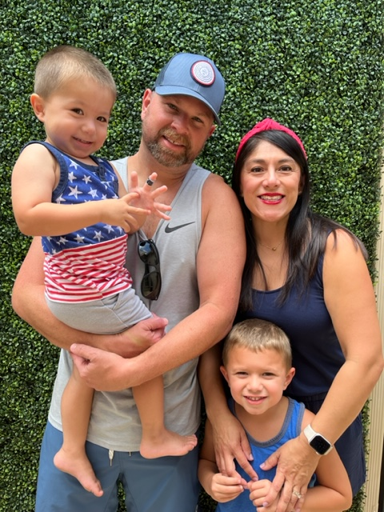
Who Is Mrs. Johnson? -A mom to Brady (5 ½ years) & Dylan (3 years) -A wife to Eric for 9 years -An avid baker, chocolate addict and traveler -A product of Catholic grade school and high school -A teacher in her 20th year of teacher! (Wow that makes me feel old.) Education -B.S. Liberal Studies, Minor in Child Development, California Polytechnic University San Luis Obispo -Multi-Subject Cross-Cultural Language and Academic Credential (CalPoly SLO) -Autism Specialist Certified -19 years teaching in Catholic Schools in California and Arizona

Slide 4
Take A Look Into 2A…
Daily Morning Routine
Wash Hands upon entering the room
Morning Work
Agenda and Reading Log Check
Pledge, Prayer, Mission Statement
Preview the daily schedule

Slide 5
Language Arts - CKLA Amplify Reading Series -Divided into 2 Strands Skills: phonics, spelling, grammar, writing, decoding skills needed for independent reading Knowledge: help students build the background knowledge and vocabulary critical to listening and reading comprehension Handwriting -Zaner-Bloser -Manuscript and Cursive Math -Big Ideas (Workbook, interactive, hands on activities) -Problem solving skills through word problems -Mad Minutes to improve math fact fluency (multiplication) -Whole group lessons, independent and guided practice

Slide 6
Religion -Morning & Afternoon Prayer -Weekly Mass, Special Intentions -Jesus Our Guide, Faith and Life Series -Reading from the Bible -Please seek out Sacrament preparation information from your own parish Spelling -Words are taken from unit phonics focuses -Students receive words and sentences on Monday -Tests are given on Friday

Slide 7
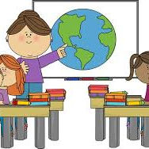
Science/Social Studies -Alternate Science & Social Studies -Curriculum follows Diocesan & State Standards -Hands on experiments, interactive learning, STEM labs -Social Studies and Science are also integrated in our reading series

Slide 8
Projects and Other Information -Students may receive projects and reports in lieu of normally scheduled assignments (President Projects, Saint Report, Book Talks). -Students will be given plenty of time and preparation. -Book Talks will be assigned quarterly. Book Talks very based on quarter.

Slide 9
Homework Policy -Homework is daily and expected to be turned in by 8 am the following day unless otherwise notified. -Agendas are used daily & need to come back daily signed. Reading Logs: Students are expected to read 10 minutes daily. Parents need to sign off each night. Logs are checked daily. The log will be submitted into Schoology into Language Arts Thursday folder of the current week. Math: Students will receive Math workbook or digital (IXL) homework 3-4 nights. These are meant as extra practice. IXL Math/Language Arts: IXL practice in a given skill may be assigned as homework.

Slide 10
Classroom Discipline Class DOJO -Students may earn or lose points for following classroom rules, expectations, turning in homework on time and participation throughout the day in all classes. -Students are shown their points at the end of every day and it is their responsibility to claim rewards. Additional Actions: -Name on board -Reflection time during recess on what better choices could have been made -Incident Reports Our main goal in 2A is for students to accept responsibility for both negative and positive choices. If a student is able to acknowledge that they made a mistake, then they are able to learn from that mistake and make a better choice next time.

Slide 11
ITBS -Spring date TBD Drop Off -Classroom doors will open at 7:30 -Students will have daily morning bell work to be completed by 8:10 am. Absences -If your child is absent, any missed work that cannot be completed in class will be sent home. They have the same number of days missed to complete the assignments. Schoology -Students will begin to use Schoology in the second half of the year to complete quizzes, assignments or submit work. -This is to help them transition into using Schoology in 3rd grade -Graded Work can be viewed in Schoology Grades -Grades are updated daily. Please access RenWeb for student grades and comments.

Slide 12
Other Continued… Snack -Every morning -Please be sure to adhere to Diocese policy (healthy options only) -No nuts! Lunch -In the classroom -No Nuts until we return to cafeteria lunch Birthdays -We love to celebrate birthdays in 2A. I ask that you please reach out to me before sending in treats to the class.

Slide 13
Student Expectations Work Ethic: Students are expected to put in their full effort into neatness, answering questions correctly and thoroughly, turning in assignments on time, participating in class and showing their teachers, classmates and themselves respect. Self-Accountability: Students are responsible for entering and exiting their classroom prepared for the day ahead. It is their responsibility to have their work, be ready to participate and be kind to one another. Please help support their independence and encourage a strong work ethic. Mistakes happen, please help them learn from their mistakes. If an assignment was accidentally not completed, I encourage them to turn it in the following day and to accept that consequences. It will help them in the end. Agendas/Yellow Folder/Green Folder -Homework & Spelling words will be written down by the student in agendas. -Yellow folders (HW) and agendas should come back and forth to school everyday. -Friday Green Folders will have graded paperwork and returned on Mondays with parent log signed.

Slide 14
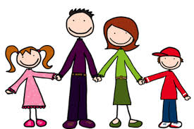
It Takes A Village… If you ever have a question or concern, please feel free to email me. Communication is one of my top priorities. Nothing should come as a surprise. Weekly Newsletters are posted to our class website every Sunday. I do my best to respond to emails promptly. Please don’t ever feel that I’m ignoring your email. Homework is posted daily by 3:30 pm. on our class website. Remember we are all in this journey together, students, parents and teachers. Unexpected life events happen. Let’s help each other out. Thank you for your patience, flexibility, kindness and support. Let’s make this year a great one!

